Slide 1


HEP NTUA Weekly Report 6/10/2020
George Bakas

Slide 2
Summary
Analysis:
Start investigating ttbar Systematic Uncertainties
Consistency checks with Giannis
Top Angular Distributions: chi, |cosθ*| leading and subleading
Responses, Signal Extraction →Unfolding
Results
Changed binning for the cos(θ*) distributions:
EFT interpretation
Angular distributions with EFT parameters
AN 2020/156

Slide 3
Signal Selection
Control Region Selection
Variables | Selected Cut
pT (both leading jets) | > 400 GeV
Njets | > 1
N leptons | = 0
|eta| (both leading jets) | < 2.4
mJJ | > 1000 GeV
jetMassSoftDrop (only for fit) | (50,300) GeV
Top Tagger | > 0.2, 0, 0.1
B tagging (2 btagged jets) | > Medium WP
Signal Trigger
Variables | Selected Cut
pT (both leading jets) | > 400 GeV
Njets | > 1
N leptons | = 0
|eta| (both leading jets) | < 2.4
mJJ | > 1000 GeV
jetMassSoftDrop (only for fit) | (50,300) GeV
Top Tagger | > 0.2, 0, 0.1
B tagging (0 btagged jets) | < Medium WP
Control Trigger

Slide 4
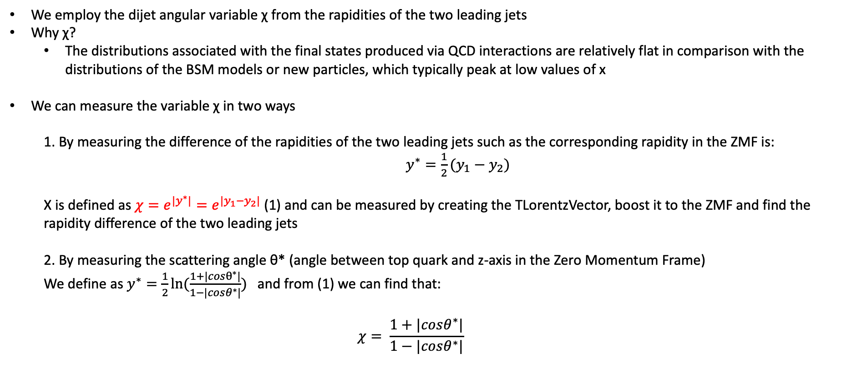
Top Angular Distributions
We employ the dijet angular variable χ from the rapidities of the two leading jets
Why χ?
The distributions associated with the final states produced via QCD interactions are relatively flat in comparison with the distributions of the BSM models or new particles, which typically peak at low values of x
We can measure the variable χ in two ways
1. By measuring the difference of the rapidities of the two leading jets such as the corresponding rapidity in the ZMF is: $y^{∗}=\frac{1}{2}(y_{1}−y_{2})$
Χ is defined as $χ=e^{{|y}^{∗}|}=e^{|y_{1}−y_{2}|}$ (1) and can be measured by creating the TLorentzVector, boost it to the ZMF and find the rapidity difference of the two leading jets
2. By measuring the scattering angle θ* (angle between top quark and z-axis in the Zero Momentum Frame)
We define as $y^{∗}=\frac{1}{2}ln⁡(\frac{1+|cosθ^{∗}|}{1−|cosθ^{∗}|})$ and from (1) we can find that:
$$χ= \frac{1+|cosθ^{∗}|}{1−|cosθ^{∗}|}$$

Slide 5
Response Matrices

Slide 6
Response Matrices

Slide 7
Signal Extraction
Fitted number of QCD events in SR_{A}
Measured dist from data
QCD shape taken from Data (CR)
$$S\left(x_{reco}\right)=D\left(x_{reco}\right)−C_{bkg}^{yield}N_{QCD}^{fit}\left(x_{reco}\right)Q\left(x_{reco}\right)−B(x_{reco})$$
Fiducial Yield
Transfer factor from SR_{A} to SR
Subdominant bkg shape and contribution (MC)
Where x_{reco} is the respected variable of interest (ttbar mass, pt, rapidity, leading and subleading jetPt and |jetY|)
We deploy a fit in the Signal Region (2btag) to extract the $N_{QCD}^{fit}$
$$D{\left(m^{t}\right)}^{(i)}=N_{tt}^{(i)}T^{(i)}\left(m^{t},k_{MassScale}, k_{MassResolution}\right)+N_{bkg}^{(i)}B\left(m^{t} \right)\left(1+k_{1}x\right)+N_{sub}^{(i)}O^{(i)}\left(m^{t}\right)$$
Our data CR is contaminated from ttbar and subdominant bkgs which has to be dealt with.

Slide 8
Fiducial Measurement
(2016)
(2016)

Slide 9
Fiducial Measurement
(2016)
(2016)

Slide 10
Parton Measurement
(2016)
(2016)

Slide 11
Parton Measurement
(2016)
(2016)

